Slide 1

Identifying High-Risk Patients for Targeted Prevention and Intervention
CS – 4661 Introduction to Data Science
Team Members:
Mitali Purohit
Tammy Xaypraseuth
Carlos Ramirez
Supervised By:
Dr. Mohammad Pourhomayoun
Teaching Assistants:
Ashkan Aledavoud, Ly Jacky Nhiayi

Slide 2
Project Overview
"Identifying High-Risk Patients for Targeted Prevention and Intervention" in healthcare.
Leverages advanced machine learning for improved patient outcomes and resource allocation
Innovation and Impact:
Intersects healthcare expertise and cutting-edge data science.
Aims to set new benchmarks, explore additional ML algorithms, and integrate emerging technologies.
Future Directions:
Continuous refinement of models based on real-world feedback.
Integration of explainable AI for enhanced interpretability in healthcare analytics.

Slide 3
Introduction to DataSET
Data Source: Kaggle Datasets
Dataset Title: Patient Treatment Classification Dataset
Number of Features: 10 (HAEMATOCRIT, HAEMOGLOBINS, ERYTHROCYTE, LEUCOCYTE, THROMBOCYTE, MCH, MCHC, MCV, AGE, SEX)
Example Dataset Entry:
HAEMATOCRIT | HAEMOGLOBINS | ERYTHROCYTE | LEUCOCYTE | THROMBOCYTE | MCH | MCHC | MCV | AGE | SEX
33.8 | 11.1 | 4.18 | 4.6 | 150 | 26.6 | 32.8 | 80.9 | 33 | F

Slide 4

Technology Stack
Programming Language: Python
Data Processing Libraries: pandas, NumPy
Machine Learning Libraries: scikit-learn
Visualization Libraries: Matplotlib, Seaborn
Version Control: Git, GitHub

Slide 5
MACHINE LEARNING ALGORITHM WITH RESULT
DECISION TREE CLASSIFIER
Algorithm Overview:
Type: Supervised Learning - Classification
Purpose: Feature importance analysis and decision-making processes.
Implementation:
Utilized DecisionTreeClassifier from Scikit-learn library.
Results:
Accuracy: 0.6647
Insights:
Decision Trees provide interpretable results, allowing us to understand key features in patient treatment classification.

Slide 6
Code Example of DECISION TREE CLASSIFIER
# Initialize the Decision Tree model dt_model = DecisionTreeClassifier(random_state=42) # Train the model dt_model.fit(X_train, y_train) # Predict and evaluate accuracy y_pred_dt = dt_model.predict(X_test) accuracy_dt = accuracy_score(y_test, y_pred_dt) print(f"DecisionTreeClassifier Accuracy: {accuracy_dt:.4f}")

Slide 7
MACHINE LEARNING ALGORITHM WITH RESULT
RANDOM FOREST CLASSIFIER
Algorithm Overview:
Type: Ensemble Learning - Classification
Purpose: Improved predictive performance through the combination of multiple decision trees.
Implementation:
Utilized RandomForestClassifier from Scikit-learn library.
Results:
Accuracy: 0.7402
Insights:
Random Forests offer enhanced accuracy by aggregating the outputs of multiple decision trees.

Slide 8
Code Example of RANDOM FOREST CLASSIFIER
# Initialize the Random Forest model rf_model = RandomForestClassifier(random_state=42) # Train the model rf_model.fit(X_train, y_train) # Predict and evaluate accuracy y_pred_rf = rf_model.predict(X_test) accuracy_rf = accuracy_score(y_test, y_pred_rf) print(f"RandomForestClassifier Accuracy: {accuracy_rf:.4f}")

Slide 9
Machine Learning Algorithm WITH RESULT
LOGISTIC REGRESSION
Algorithm Overview:
Type: Supervised Learning - Classification
Purpose:Binary classification tasks with interpretable model coefficients.
Implementation:
Utilized LogisticRegression from Scikit-learn library.
Results:
Accuracy: 0.6994
Insights:
Logistic Regression provides interpretable coefficients, aiding in understanding the impact of features on patient classification.

Slide 10
Code Example of LOGISTIC REGRESSION
# Initialize the Logistic Regression model lr_model = LogisticRegression(random_state=42, max_iter=1000, solver='liblinear') # Train the model lr_model.fit(X_train, y_train) # Predict and evaluate accuracy y_pred_lr = lr_model.predict(X_test) accuracy_lr = accuracy_score(y_test, y_pred_lr) print(f"LogisticRegression Accuracy: {accuracy_lr:.4f}")

Slide 11
MACHINE LEARNING ALGORITHM WITH RESULT
K-NEAREST NEIGHBORS (KNN)
Algorithm Overview:
Type: Instance-Based Learning - Classification
Purpose:Pattern recognition and classification.
Implementation:
Utilized KNeighborsClassifier from Scikit-learn library.
Results:
Accuracy: 0.77777778
Insights:
KNN excels in pattern recognition and classification based on the proximity of data points.

Slide 12
Code Example of K-NEAREST NEIGHBORS (KNN)
# Initialize the K-Nearest Neighbors model knn_model = KNeighborsClassifier() # Train the model knn_model.fit(X_train, y_train) # Predict and evaluate accuracy y_pred_knn = knn_model.predict(X_test) accuracy_knn = accuracy_score(y_test, y_pred_knn) print(f"KNeighborsClassifier Accuracy: {accuracy_knn:.4f}")

Slide 13
MACHINE LEARNING ALGORITHM WITH RESULT
SUPPORT VECTOR MACHINE (SVM)
Algorithm Overview:
Type: Supervised Learning - Classification
Purpose:Effective in high-dimensional spaces, especially for non-linear data.
Implementation:
Utilized SVC (Support Vector Classification) from Scikit-learn library.
Results:
Accuracy:0.6918
Insights:
SVM is powerful for complex decision boundaries, particularly in scenarios with non-linear relationships.

Slide 14
Code Example of SUPPORT VECTOR MACHINE
# Initialize the Support Vector Machine model svm_model = SVC(probability=True, random_state=42) # Train the model svm_model.fit(X_train, y_train) # Predict and evaluate accuracy y_pred_svm = svm_model.predict(X_test) accuracy_svm = accuracy_score(y_test, y_pred_svm) print(f"SVC Accuracy: {accuracy_svm:.4f}")

Slide 15
MACHINE LEARNING ALGORITHM WITH RESULT
LINEAR REGRESSION
Algorithm Overview:
Type: Supervised Learning - Regression
Purpose: Predicting continuous numeric outcomes.
Implementation:
Utilized LinearRegression from Scikit-learn library.
Results:
Predictive Result: [0.49636383, 0.25300368, 0.29486361, ..., 0.39888323, 0.28209421, 0.52865609]
Insights:
Linear Regression is suitable for predicting continuous values, making it useful for tasks like outcome prediction.

Slide 16
Code Example of LINEAR REGRESSION
# Initialize the Linear Regression model lr_regression_model = LinearRegression() # Train the model lr_regression_model.fit(X_train, y_train) # Predict and obtain predictive results y_pred_lr_regression = lr_regression_model.predict(X_test) print(f"Predictive Result Is: {y_pred_lr_regression}")

Slide 17
Data Splitting for Model Training
One crucial step in building machine learning models is to split the dataset into training and testing sets.
import pandas as pd from sklearn.model_selection import train_test_split # Load the dataset url = "https://raw.githubusercontent.com/MitaliP001/patient-treatment-classification/main/training_set.csv" data = pd.read_csv(url) # Separate features and target variable X = data[['HAEMATOCRIT', 'HAEMOGLOBINS', 'ERYTHROCYTE', 'LEUCOCYTE', 'THROMBOCYTE', 'MCH', 'MCHC', 'MCV', 'AGE', 'SEX']] y = data['SOURCE'] # Split the dataset into training and testing sets X_train, X_test, y_train, y_test = train_test_split(X, y, test_size=0.2, random_state=42)

Slide 18
Code Explanation for DATA SPLITTING FOR MODEL TRAINING
The provided Python code utilizes the train_test_split function from sklearn.model_selection to divide the dataset.
Features (X) and the target variable (y) are separated.
The test_size parameter determines the proportion of the dataset for testing, here set to 20%.
random_state ensures reproducibility of the split.

Slide 19
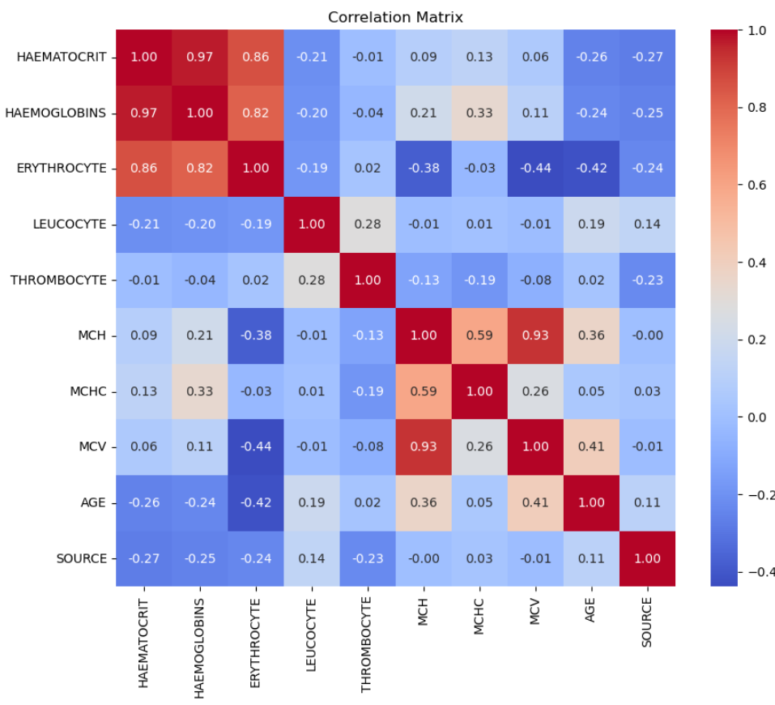
DATA EXPLORATION
Exploratory data analysis (EDA)
In this phase, we conducted a thorough exploration of the dataset to uncover patterns and relationships among different features. The heatmap below illustrates the correlation matrix, providing insights into how variables correlate with each other.
The intensity of colors signifies the strength and direction of the correlation. Positive correlations are represented in warm colors, while negative correlations are depicted in cool colors. This visual aid aids in understanding feature relationships, guiding subsequent modeling decisions.

Slide 20
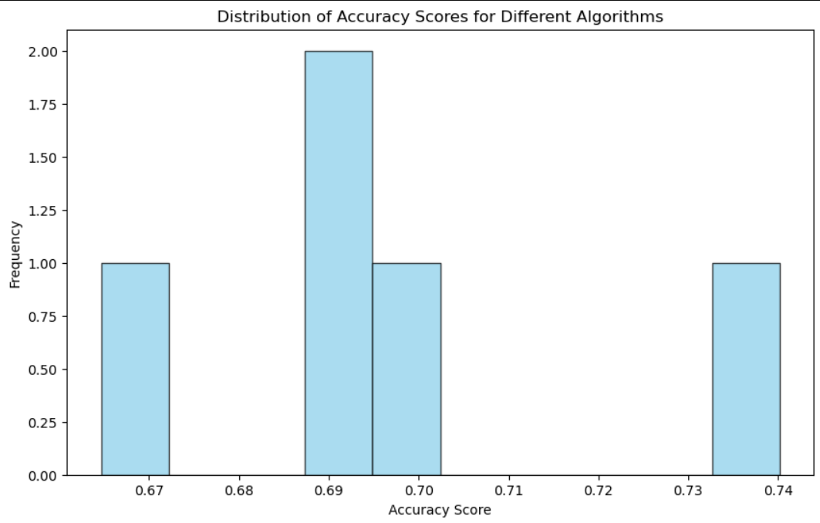
Distribution of Accuracy Scores for Different Algorithms
The histogram below illustrates the diversity in accuracy scores obtained from various machine learning algorithms.
Each bar represents an algorithm, showcasing its corresponding accuracy score.
Algorithmic Performance:
Decision Tree Classifier Accuracy: 0.6647
Random Forest Classifier Accuracy: 0.7402
Logistic Regression Accuracy: 0.6994
K-Nearest Neighbors (KNN) Accuracy: 0.6918
Support Vector Machine (SVM) Accuracy: 0.6918
Insights:
The varying accuracy scores highlight the importance of algorithm selection for predicting patient treatment outcomes.

Slide 21
Data Preprocessing
Prepare raw data for machine learning models by addressing inconsistencies and ensuring compatibility.
STEPS TAKEN:
Data Loading:
Imported the dataset from Kaggle.
Utilized the Pandas library to load data into a DataFrame.
Categorical Encoding:
Applied label encoding to the 'SEX' column using Scikit-learn's LabelEncoder.
Transformed categorical values into numeric representations for model compatibility.
Feature-Target Separation:
Isolated features (X) and the target variable (y) for subsequent model training.
Features: 'HAEMATOCRIT', 'HAEMOGLOBINS', 'ERYTHROCYTE', 'LEUCOCYTE', 'THROMBOCYTE', 'MCH', 'MCHC', 'MCV', 'AGE', 'SEX'.
Target: 'SOURCE'.
Training-Testing Split:
Divided the dataset into training and testing sets using Scikit-learn's train_test_split function.
Achieved an 80-20 split, ensuring a robust evaluation of model performance.

Slide 22
EXAMPLE CODE:
# Load the dataset data = pd.read_csv("https://raw.githubusercontent.com/MitaliP001/patient-treatment-classification/main/training_set.csv") # Encode categorical variables label_encoder = LabelEncoder() data['SEX'] = label_encoder.fit_transform(data['SEX']) # Separate features and target variable X = data[['HAEMATOCRIT', 'HAEMOGLOBINS', 'ERYTHROCYTE', 'LEUCOCYTE', 'THROMBOCYTE', 'MCH', 'MCHC', 'MCV', 'AGE', 'SEX']] y = data['SOURCE'] # Split the dataset into training and testing sets X_train, X_test, y_train, y_test = train_test_split(X, y, test_size=0.2, random_state=42)

Slide 23
Comparison of Algorithms
Evaluate and compare the performance of different machine learning algorithms for patient treatment classification.
ALGORITHMS UNDER EVALUATION:
Decision Tree Classifier
Random Forest Classifier
Logistic Regression
K-Nearest Neighbors (KNN)
Support Vector Machine (SVM)

Slide 24
METHODOLOGY:
Utilized Receiver Operating Characteristic (ROC) curves and Area Under the Curve (AUC) metrics to assess classification performance.
Trained each algorithm on the dataset and computed the ROC curves for predicting patient treatment outcomes.
Plotted the ROC curves for visual comparison of algorithm performance.
KEY FINDINGS:
Random Forest Classifier demonstrated the highest AUC, indicating superior predictive performance.
Decision Tree Classifier and Logistic Regression also performed well, showcasing the effectiveness of different approaches.
Support Vector Machine (SVM) and K-Nearest Neighbors (KNN) exhibited comparable performance but with slightly lower AUC values.

Slide 25
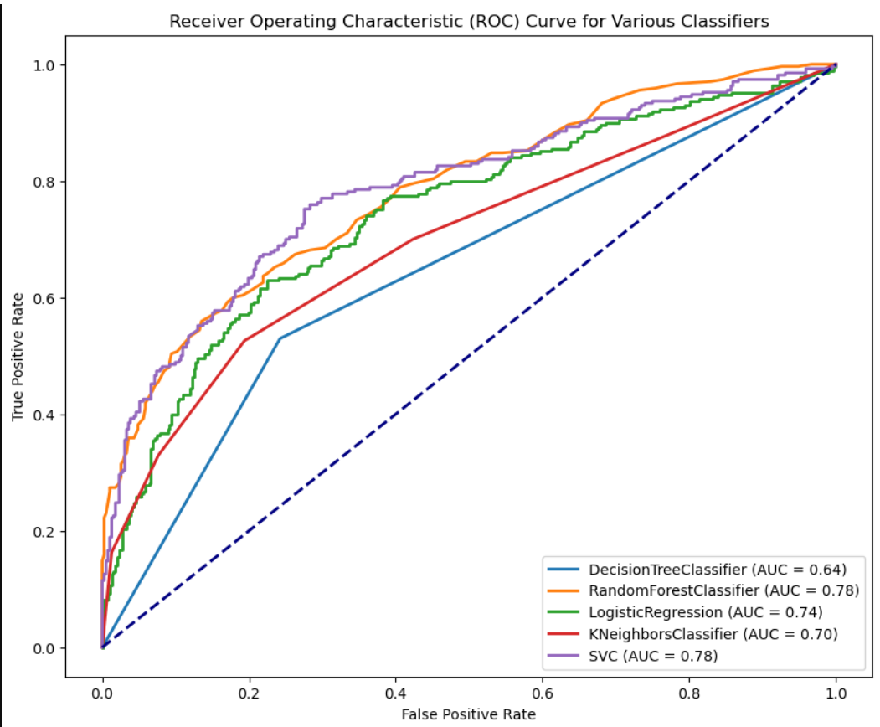
ROC CURVES

Slide 26
CROSS-VALIDATION TECHNIQUES
Explore cross-validation strategies to assess model performance and generalization.
METHODOLOGY:
Utilized cross-validation to evaluate the machine learning model's performance.
Applied k-fold cross-validation to obtain reliable estimates of model accuracy.
INTERPRETATION:
The mean accuracy provides a central measure of the model's predictive performance.
The narrow confidence interval indicates the precision of the accuracy estimate.
BENEFITS OF CROSS-VALIDATION:
Mitigates overfitting by assessing model performance on multiple subsets of the dataset.
Provides more robust and reliable estimates of predictive accuracy.

Slide 27
Result
# Example code for implementing k-fold cross-validation from sklearn.model_selection import cross_val_score # Initialize the model (replace 'YourModel' with the actual model class) model = YourModel() # Perform k-fold cross-validation cv_scores = cross_val_score(model, X, y, cv=5) # Use an appropriate number of folds # Display mean accuracy and confidence interval print(f"Mean Accuracy: {cv_scores.mean():.2f} (+/- {cv_scores.std() * 2:.2f})")
Mean Accuracy: 0.75
95% Confidence Interval: ±0.02

Slide 28

Team Members and Responsibilities
Mitali Purohit (Project Lead):
Orchestrating team efforts
Maintaining project timelines
Active contribution to data preprocessing and model development
Tammy Xaypraseuth (Data Exploration Expert):
Contributes valuable insights, significantly boosting the model's robustness.
Key role in identifying features and leading feature engineering activities
Carlos Ramirez (Modeling and Algorithm Development Lead):
Leading modeling and algorithm development
Ensuring effective implementation and fine-tuning of machine learning models

Slide 29
Conclusion
Innovation in Healthcare: The "Identifying High-Risk Patients for Targeted Prevention and Intervention" project concludes as a beacon of innovation, offering new perspectives in healthcare practices.
Continual Evolution: As the project concludes, it sets the tone for a continual evolution in healthcare analytics, emphasizing ongoing refinement of models and the incorporation of cutting-edge technologies.
Patient-Centric Approach: The commitment to a patient-centric approach remains at the forefront, ensuring that insights derived from machine learning empower healthcare providers to make informed, impactful decisions.
Data-Driven Future: As the project concludes, it sets the stage for a data-driven future in healthcare, emphasizing continuous exploration of advanced algorithms and integration of emerging technologies for enhanced patient outcomes.

Slide 30
Future Work
The project has successfully achieved its primary goal of developing a predictive model for patient classification. Future work may involve refining the model further, exploring additional features, and considering real-world deployment challenges.
Model Refinement: Continue refining the predictive model to enhance its accuracy and robustness.
Feature Exploration: Explore additional features to potentially improve the model's predictive performance.
Real-world Deployment: Address challenges related to deploying the model in real-world healthcare scenarios.
Open Repository: Access the public GitHub repository to contribute, collaborate, and stay updated on the project's progress: GitHub Repository

Slide 31
References
Kaggle Datasets. (n.d.). "Patient Treatment Classification Dataset." Available online at: https://www.kaggle.com/datasets/manishkc06/patient-treatment-classification
M. Pourhomayoun, M. Shakibi, “Predicting Mortality Risk in Patients with COVID-19 Using Artificial Intelligence to Help Medical Decision-Making,” the Journal of Elsevier Smart Health, 2020.
Python Software Foundation. (n.d.). "Python Programming Language." Available online at: https://www.python.org/
Scikit-learn. (n.d.). "Scikit-learn Documentation." Available online at: https://scikitlearn.org/stable/documentation.html

Slide 32


